Slide 1




Sub-regional Workshop on Use and Implementation of RETOSTM for Oil Spill Response Program Assessment
Central and Eastern Mediterranean – Concluding Plenary Session
23 November 2021
VIRTUAL
Project funded by the European Union Civil Protection DG ECHO - EC

Slide 2
Agenda
Schedule | Activity | Facilitator
13:00 – 13:30 | Opening Speech Institutional experience in the use of the Readiness Evaluation Tool of Oil Spills | REMPEC ARPEL
13:30 – 14:15 | Overview of preliminary informal assessments for the region | E. Taylor, ITOPF & Sea Alarm
14:15 – 14:30 | Synthesis of the outputs of the Country specific session | E. Taylor& REMPEC
14:30 – 15:15 | Discussion and Questions – Common Challenges, Observations, Clarifications, and Implementation | All
15:15 – 15:30 | Break
15:30 – 15:45 | Next Steps and Concluding Discussions | E. Taylor& REMPEC
15:45 – 16:15 | Workshop Evaluation & Feedback | All
16:15 – 16:45 | Closing Remarks | REMPEC

Slide 3
Activity Sessions
SESSION 1: Initial Plenary Sessions
7 – 8 September 2021
SESSION 2: Breakout sessions with each country
(with support from REMPEC Consultants)
21 September – 4 November
SESSION 3: Final Plenary Session
23 November 2021

Slide 4
REMPEC Activity Objectives
Provide training on oil spill preparedness and contingency planning, as well as developing hands-on working knowledge of the use, and advantages, of the RETOS application for analysing and identifying gaps in national oil spill preparedness and response programs and areas for improvement
Provide guidance on using RETOS and associated tools to conduct national OSR preparedness assessment workshops
Provide guidance on using the Self Assessment Tool (SAT) for Oiled Wildlife Response to complement the national assessment workshops
Ultimately to provide guidance on steps and supporting resources to efficiently bridge the gaps identified

Slide 5
Goals
Ensure each participating country has the tools and a clear path forward on how to lead a National Workshop on using RETOS to produce self-assessments reports (Global Performance Analysis and Global Improvement Program) of their national oil spill contingency program
Ensure countries understand and can use the Self Assessment Tool (SAT) for Oiled Wildlife Response and identify opportunities for improvement
Identify subregional to regional opportunities to enhance spill response preparedness across the Mediterranean

Slide 6
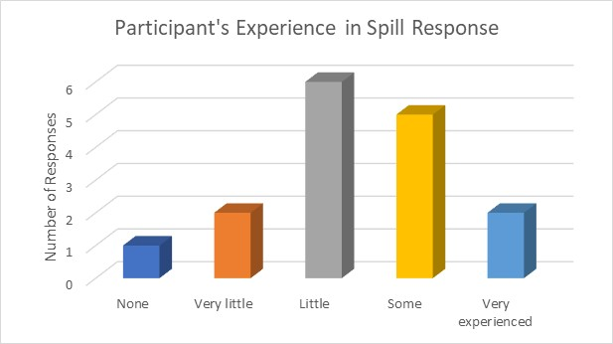
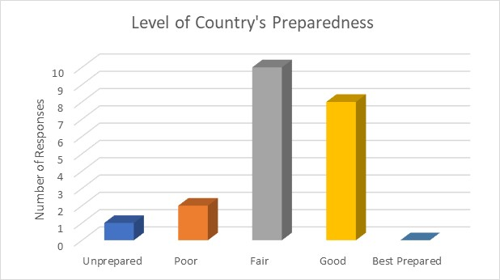
Participants – Initial Session (7-8 Sept 2021)
38 participants / 24 agencies / 13 countries

Slide 7
Overview of Country-specific Sessions
Informal Assessments

Slide 8
Phase 2 Sessions (21 Sept – 5 Nov 2021)
14 00 - 14 20 | Welcome Speech | REMPEC (Smaoui)
 | Introduction to the Workshop sessions – Context of the specific sessions | REMPEC
 | Round table to introduce the participants | Participants
14 20 – 14 30 | Organization of the specific session | Facilitator
14 30 – 15 00 | Initiation of the assessment - The excel spreadsheet | Facilitator & Participants
15:00 – 15:15 | Break
15:15 – 16:45 | Continuation of the assessment | Facilitator & Participants
16:45 – 17:00 | Way forward and closure | REMPEC/ Facilitator

Slide 9
Perspectives from Consultants & ITOPF
Dr. Elliott Taylor
  Countries: Albania, Montenegro, and Slovenia (Egypt and Lebanon)
  2-4 participants representing two to three agencies, typically one from Competent National Authority
  Experienced and engaged participants
  Participants were very open in their discussion of the tool and assessment criteria
  Country national OSR programs reflected a range of maturity
    Updated National OSR Plans: Albania, Montenegro, & Slovenia
  Formal national assessment workshops will provide opportunities to obtain feedback from a range of stakeholders AND to communicate to stakeholder the status of their national OSR program

Slide 10
Perspectives from Consultants & ITOPF
Anne Reglain
  Countries: Cyprus, Bosnia and Herzegovina, Libya, Monaco (Syria)
  Participants provided an honest assessment of their program according to their knowledge;
  The range of criteria and hence stakeholders required to conduct a representative assessment were noted by all participants;
  Some participants found that some criteria were sometimes repetitive or unclear and welcomed the initiative of a revised and improved version of the tool;
  It was noted that there were some variations on the score depending on the severity of the assessor;
  Participants were keen to use the tool for a formal assessment and also for other scopes.

Slide 11
Overview of preliminary informal assessments - ITOPF
Attendance
ITOPF facilitated four individual country sessions
  Croatia (6 October)
  Greece (11 October)
  Israel (12 October)
  Turkey (4 November)
Attendance ranged from 1 to 4 representatives per country
Introductions
ITOPF provided an overview of the purpose of the session and recap of RETOS for those participants that missed the 7-8 September kick off meeting.
Time needed to ensure all participants had the relevant files downloaded (i.e. RETOS Excel file & manual, IOSC guidelines).
ITOPF provided an example of how to use the supporting tools to find more information on a particular element.

Slide 12
Overview of preliminary informal assessments - ITOPF
Two countries had already completed a draft assessment ahead of the session, so were well prepared.
Good mix of participants with strong knowledge of their contingency programmes
Participants were mostly able to carry out the assessment (discussing in their own languages) with minimal input from ITOPF, however ITOPF remained available for questions throughout.
The importance of identifying agencies/stakeholders to participate in a national workshop/formal assessment was noted.
All countries completed their informal draft assessment in the time available – countries keen to understand next steps, for example when they can move on to carry out a Level B assessment

Slide 13
Perspectives from Sea Alarm
SAT presented during Initial Plenary Session (Session 1)
Online support provided to countries having questions (Session 2) → Question and clarification provided to one country, with potential improvement of the SAT
Limited outputs from the countries: 4 assessments carried out Albania, Egypt, Greece and Montenegro but only 3 received

Slide 14
Perspectives from REMPEC
  The beneficiaries of the self-assessments are for the Countries and REMPEC.
  At this stage the Objective is to have the knowledge of the use of the Tool. Scores are informative.
  Results of the practicability and the usefulness the toll went over the expectations.
  Will and need to go forward in improving the capacites for the self- assessments were expressed

Slide 15
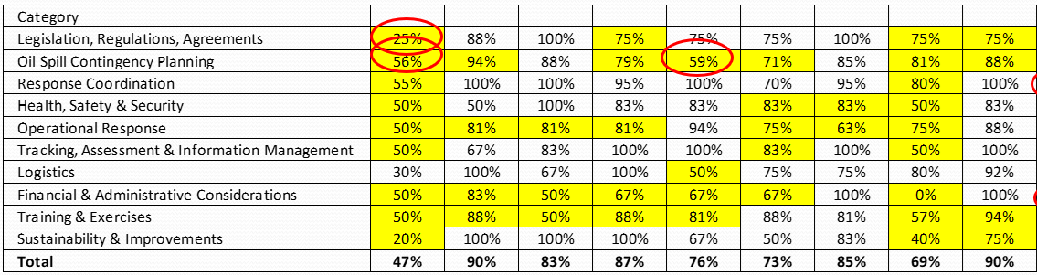
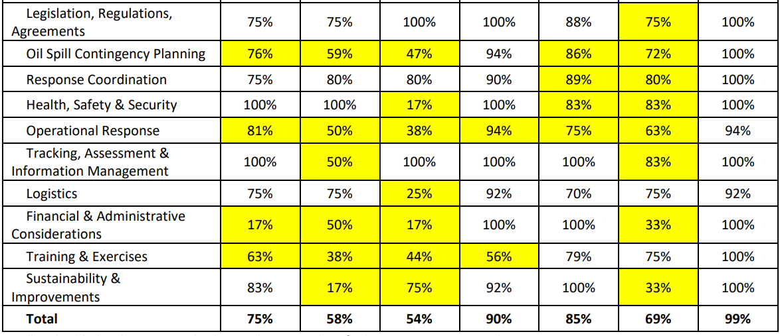
Perspectives from REMPEC
  19 Contracting Parties from the 21 have acquired the knowledge on the use of Tool and the benefits of the self-assessments
    12 Central and Eastern Mediterranean
    Countries through the this Sub-regional
    Workshop on Use and Implementation of the Tool,
    7 Western Mediterranean Countries within
    the WestMOPoCo Project, (Workshop ,
    Malta April 2019).
    Next Step PoW 2022-2023

Slide 16
Country Sessions - Synthesis

Slide 17
RETOS Informal Assessments
Date | Country | Participants invited | Participants attended | Lecturer | Evaluation forms provided | RETOS completed | Sea Alarm completed
21-09-21 | Albania | 5 | 5 | ET | 1 | √ | √
29-09-21 | Bosnia and Herzegovina | 7 | 4 | AR | 4 | √
06-10-21 | Croatia | 5 | 2 | DS | 2
28-09-21 | Cyprus | 5 | 2 | AR | 2 | √
05-10-21 | Egypt | 6 | 0 | ET | 0 | √* | √
11-10-21 | Greece | 3 | 2 | AP | 0 | √ | √
12-10-21 | Israel | 3 | 3 | PR | 0 | √
14-10-21 | Lebanon | 2 | 0 | N/A | 0
20-10-21 | Libya | 4 | 3 | AR | 1 | √
26-10-21 | Monaco | 2 | 1 | AR | 1 | √
01-11-21 | Montenegro | 3 | 4 | ET | 2 | √ | √
28-10-21 | Slovenia | 3 | 2 | ET | 2 | √
21-10-21 | Syria | 2 | 0 | N/A | 0
04-11-21 | Turkey | 5 | 1 | ALM | 0
 | 14 Total |  |  |  | 15 | 10 | 4

Slide 18
Synthesis of RETOS Informal Assessments

Slide 19
Results – Informal Assessments
Legislation, Regulations, Agreements
Operational Response
Response Coordination
Health, Safety & Security
Legislation in place but transposition into national law in progress for some
Signatory to the main international conventions
Missing detailed operational plans and policies (regional vs national)
Need SIMA/NEBA for consideration of alternative response measures
Most countries meet all Level A critical criteria
Standards and norms are generally in place
Logistics
Sustainability & Improvement
Establish tracking mechanism to ensure post-action report recommendations are enacted.
Overall lack of detailed logistics
Consider improved testing of delivery times
Oil Spill Contingency Planning
Tracking, Assessment & Information
Lack of coherence and connection between various contingency plans
Lack of revision and updating process
Stronger ties needed for supporting documents and procedures.
Training & Exercises
Most critical criteria are met
Roles and responsibilities are unclear in some countries
Finance & Administration
All countries conduct exercises on a regular basis, but a clear training strategy is missing for some.
Opportunities for realistic and regional exercises
Funds to support OSR are available in most countries but not all have dedicated emergency funds.

Slide 20
Level A – OSR Readiness
Has a response capacity commensurate to the scope of its contingency plan
Has a Plan that meets, at a minimum, the applicable regulatory requirements
Has performed a basic oil spill risk analysis and identified key sensitive areas
Has a contingency plan that clearly states the response strategies to be used in a safe manner
Has a contingency plan that addresses logistical requirements and realistic response times based on adequate communications and reporting

Slide 21
Level A – OSR Readiness
Has an elementary waste management plan (temporary storage, transport, tracking and disposal options)
Has a spill response management structure that is contractible and expandable according to the needs of a response
Holds regular training of its response personnel and exercises of its contingency plan
Has financial mechanisms in place to provide emergency funds to initiate response and procedures to receive claims
Reviews and updates its contingency plan and implements

Slide 22
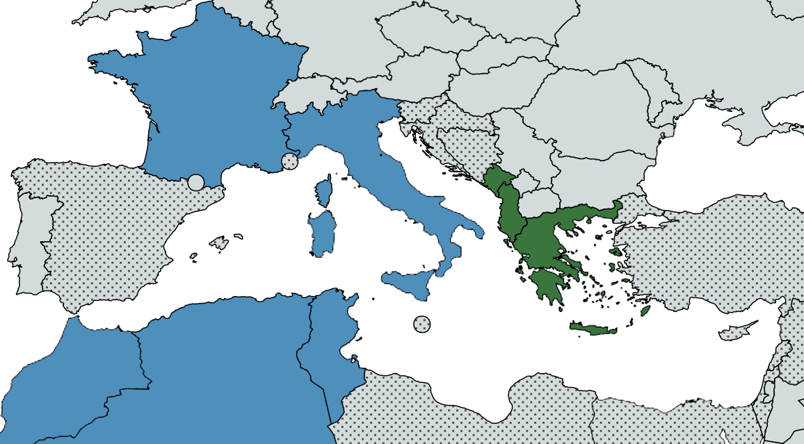
SAT Oiled Wildlife Response- Informal Assessments
West MOPoCo results (2019)
Results (2021)
Missing Mediterranean
Countries
Outside the Mediterranean

Slide 23
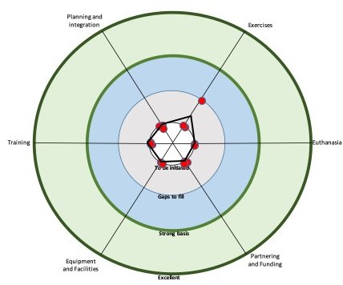
SAT Oiled Wildlife Response- Informal Assessments (2019)
Involvement during the West MOPoCo Project
Sea Alarm presented the SAT for Oiled Wildlife Response during a regional workshop organised in Valletta, Malta in 2019.
The results obtained from Algeria, France, Italy, Morocco and Tunisia gave a good overview of the level of OWR preparedness in these countries
  Early stage of preparedness for most of the countries
  Different profiles
  Gaps identified to be included in respective improvement programmes

Slide 24
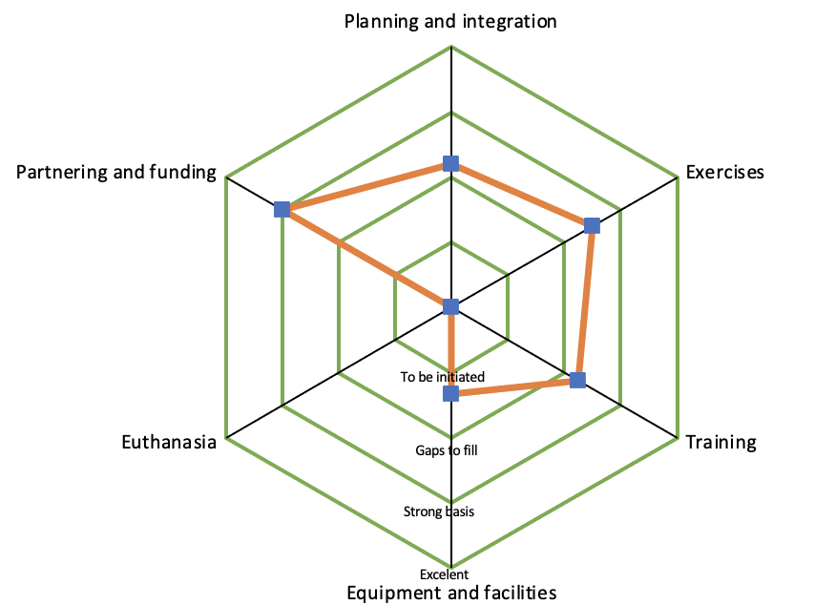
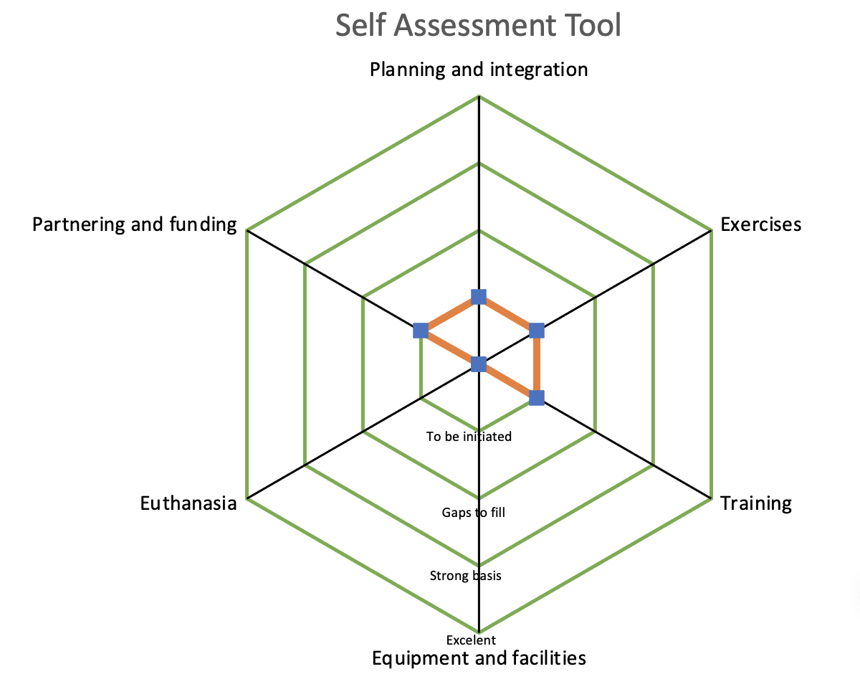
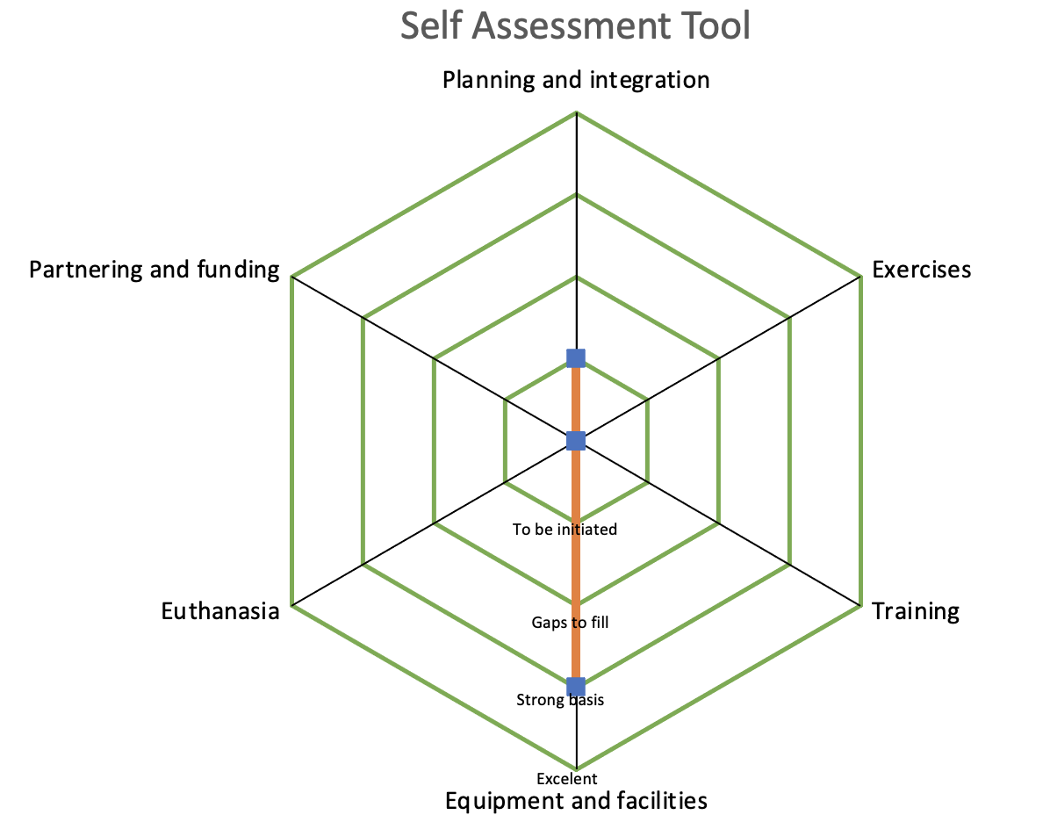
SAT Oiled Wildlife Response - Informal Assessments (2021)
Results obtained from 3 countries Albania, Greece and Montenegro but incomplete (categories and statements incomplete and/or not assessed)
Analysis:
Instructions not clear?
Assessors lacking information to complete SAT?
Lack of resources (assessors / time) to complete SAT ?
Ouputs
Challenging to get to firm conclusions

Slide 25
SAT Oiled Wildlife Response- Informal Assessments (2021)
We would like to hear from you – POLL
Question 1. Did you try to complete the Self Assessment Tool (SAT) for Oiled Wildlife Response?
1 – Yes
2 – No
Question 2 – How did you find it?
1 – Easy to complete
2 – A bit difficult to complete
3 – Too difficult to complete
Question 3 – How do you think we could improve countries to complete the SAT?
1 – Having a group session to go through the SAT and explain how it works and how to complete
2 – Having individual sessions supporting the completion of the SAT
3 – None of the above, SAT was not completed due to lack of time / resources to work on it

Slide 26
Perspectives from Participating Countries
RETOS Poll
Sea Alarm Poll
Discussion
  Perception of the assessment tools (RETOS and Sea Alarm)
  Strengths and major opportunities in country
  Common challenges
  Additional needs for formal assessments

Slide 27


BREAK

Slide 28
Next Steps

Slide 29
ITOPF involvement in West MOPoCo RETOS workshops
As part of the West MOPoCo project, ITOPF facilitated the National Oil Spill Response Contingency Plan Self-Assessment Workshops of Morocco, Malta, Tunisia and Algeria in late 2019/early 2020.
Each workshop used RETOS to help the assessment of the plans and were followed by a report from ITOPF highlighting the current barriers to implementing and recommendations to improve the plan.
ITOPF presented a synthesis of the outcomes of the assessments at the online conference MEDEXPOL in October 2020.
The four countries expressed their appreciation for ITOPF’s support, with some highlighting that the workshop and the subsequent report were key to getting some political and financial drive.
The workshops were a rare opportunity for NCP drafting teams to have all the key stakeholders around the table and have a common and objective assessment of the plan.

Slide 30
Formal National Assessments
Key findings from West MOPoCo:
The involvement of all relevant national government authorities is crucial for the successful use of the tool and development of an accurate Global Improvement Programme.
The services of an external consultant are recommended to facilitate the workshop since they are neutral in their stance and can act as mediators if required.

Slide 31
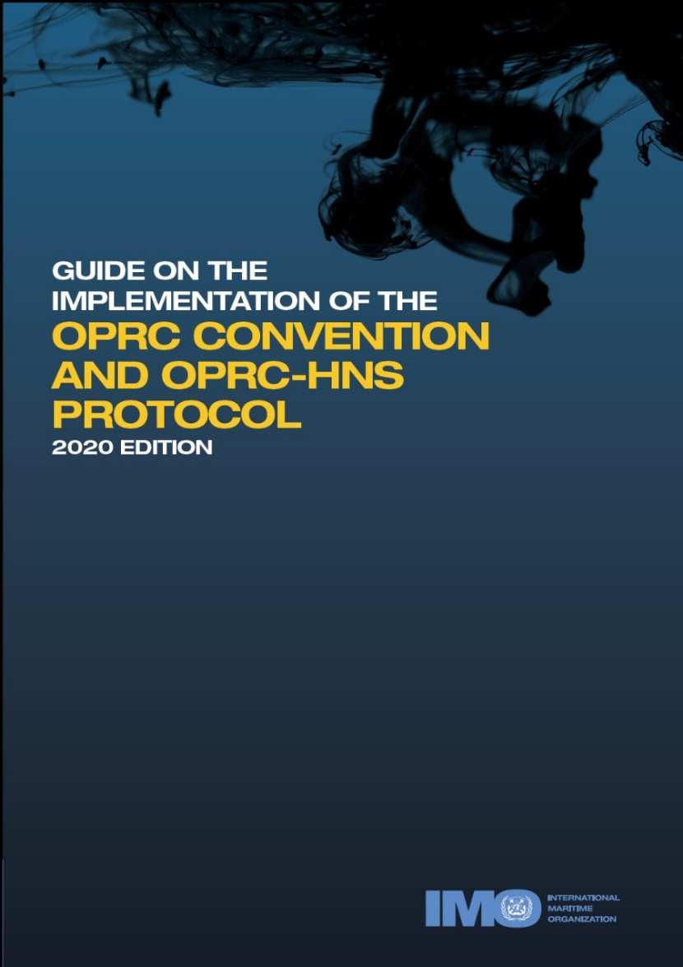

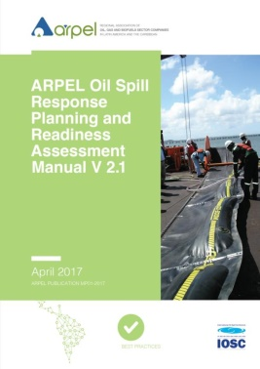

Review and assess the status of national preparedness
Identify qualified personnel to conduct assessment
Compile and review information available
Conduct interviews with key response authorities
Inspect and assess spill response equipment and logistical support assets
Complete review and identify gaps using international guides
Prioritize steps to address gaps and identify personnel/groups responsible, resources needed, and timelines
Notes:
A review and assessment of the existing national program will help to identify gaps and priorities for the response program development. Personnel in country, and/or supplemented with international expertise, must take a honest look into areas that are not developed or are ambiguous.
Gaps can be readily identified using assessment tools, such as the ARPEL RETOS tool (National scope) and/or the IMO assessment guide and checklist, which also provide guidance on how to address missing or incomplete elements in preparedness.

Slide 32
Next Steps - Stakeholders
  Identify stakeholders and cross-section of expertise in country to conduct National OSR programme assessment using RETOSTM (national oil spill contingency plan committee, including government and industry).
  Ensure cross-section to represent range of functions in spill response policy and management.
  Examples of key stakeholders include, but are not necessarily limited to:
    Civil Protection,
    Ministry of the Environment,
    Ministry of Transport,
    Harbour/Port Authority,
    Merchant Marine Authority,
    Petroleum (Mines, Energy) Ministry
    Petroleum industry representatives
    Wildlife NGOs

Slide 33
Next Steps – Skills and Knowledge
To the extent feasible, select personnel that meet the recommended attributes for oil spill assessment (as listed in the RETOSTM Manual):
    Knowledge of OSR strategies, tactics, and techniques. Actual oil spill response experience is desirable
    Knowledge of spill contingency plan development and current response practices
    Current, up-to-date knowledge of applicable regulations
    Reviewed and understand the range of elements described in the 2008 IOSC Guidelines
    Have an understanding of best practices for type of operations covered by the National OSR program
    Familiarity and access to OSR manuals and reference materials

Slide 34
Next Steps – Addressing Opportunities
  Upon completion of the RETOSTM national scope assessment, compile comments and recommendations into a RETOSTM Global Improvement Program (GIP) report.
  Complete the GIP with assignments, timelines, and required resources for top priorities in consultation with key national oil spill program stakeholders.
  Seek/receive endorsement of the GIP from top officials responsible for National oil spill preparedness (typically the Competent National Authority).
  Initiate and/or continue to undertake formalized Regional/Multilateral/Bilateral Initiatives
Local and national level notification drill and exercises
Regional drills and exercises with neighbouring countries
Develop a plan for international assistance

Slide 35
Regional Process
Regional Benchmarking
Led by REMPEC, use results for prioritizing REMPEC funding and regional to specific action plans (cost & effectiveness!!!)
Cooperation
Exchange of information and best practices – Consider systematizing through regional database: Leaders → those in need
Regional/Multilateral/Bilateral Initiatives

Slide 36
Concluding Recommendations
REMPEC to urge states to use the ARPEL tools (RETOSTM, Manual, and 2008 IOSC Guide) to conduct assessments in country for the range of OSR programs (consider the 7 scopes offered through RETOS, as applicable)
Use the outcome of the countries’ assessments with RETOS within the framework of the Mediterranean to have a better understanding of preparedness at the sub-regional level and to identify opportunities for improvements both for the countries and for future REMPEC assistance and activities.
REMPEC to urge to use the SAT for Oiled Wildlife Response to conduct assessments in country for OWR programs and use the outcomes obtained for further improvements in coordination with REMPEC

Slide 37
